Slide 1

MUSIC DATABASE
Team 2
Rashmi Baheti
Aditi Cherian
Jennifer Suiter
Notes:
Hi, we are team 2.
I am Rashmi. Aditi and Jennifer are my teammates.
Our project title is Music Database.

Slide 2
INTRODUCTION
Music database stores song details in 2 different data structures (Binary Search Tree and HashTable) to support following operations efficiently.
Searching music in the database with Song name.
Searching music in the database with Artist name.
Adding new music entries to the database.
Removing existing music entries from the database.
Printing the database in multiple ways.

Slide 3
INDIVIDUAL TASK ASSIGNMENT
Rashmi
Team Leader
HashTable Implementation
Aditi
Binary Search Tree Implementation
Documentation & Presentation
Jennifer
File I/O
Program Menu
Notes:
This slide shows how we divided the work for the project among ourselves.

Slide 4
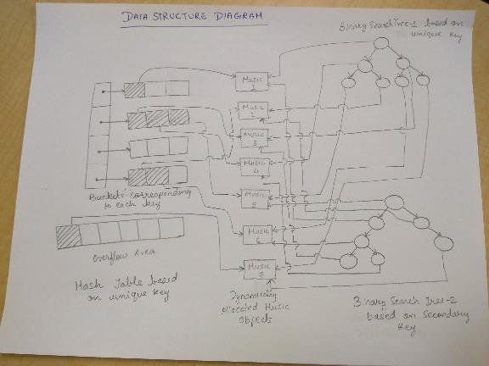
DATA STRUCTURE DIAGRAM
Notes:
This is our data structure diagram. As you can see, there are 2 BSTs.
First BST uses song name to compare music objects.
Second BST uses artist name to compare music objects.
HashTable uses song name as key.
The music objects, shown in the middle, are shared by all three data structures.
Whenever we add a new music entry to the database, we allocate a Music object dynamically and insert pointer to that object in all 3 data structures.

Slide 5
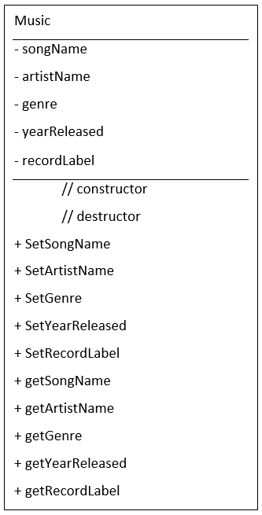
MUSIC
UML Diagram
This class tracks all details about a Music item and
has public accessor and mutator methods.
Primary Key: Song Name
Secondary Key: Artist Name
Notes:
We have a class called Music that stores all details about a Music entry.
The class has 5 attributes …
It also has public accessor and mutator methods.

Slide 6
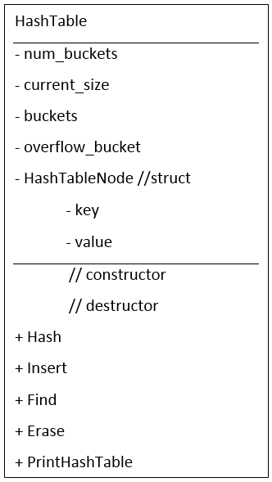
HASH TABLE
UML Diagram
This class implements a generic HashTable and can
store object pointers of any type.
Each entry in the HashTable is stored in the form of
HashTableNode.This structure stores a string key
and an object pointer corresponding to the key.
Primary area of the HashTable contains N buckets,
each storing 3 HashTableNodes in it.
Overflow area of the HashTable is a vector of
HashTableNode.
Notes:
We have class called HashTable that implements a generic HashTable and can store object pointers of any type.
Each entry in the HashTable is stored in the form of HashTableNode. HashTableNode structure has 2 attributes, a string key and an object pointer storing value corresponding to the key.
Primary area of the HashTable contains N buckets, each storing 3 HashTableNodes in it.
Overflow area of the HashTable is a vector of HashTableNode. Overflow area gets used whenever a bucket in the primary area does not have an empty slot for the new item being added.

Slide 7
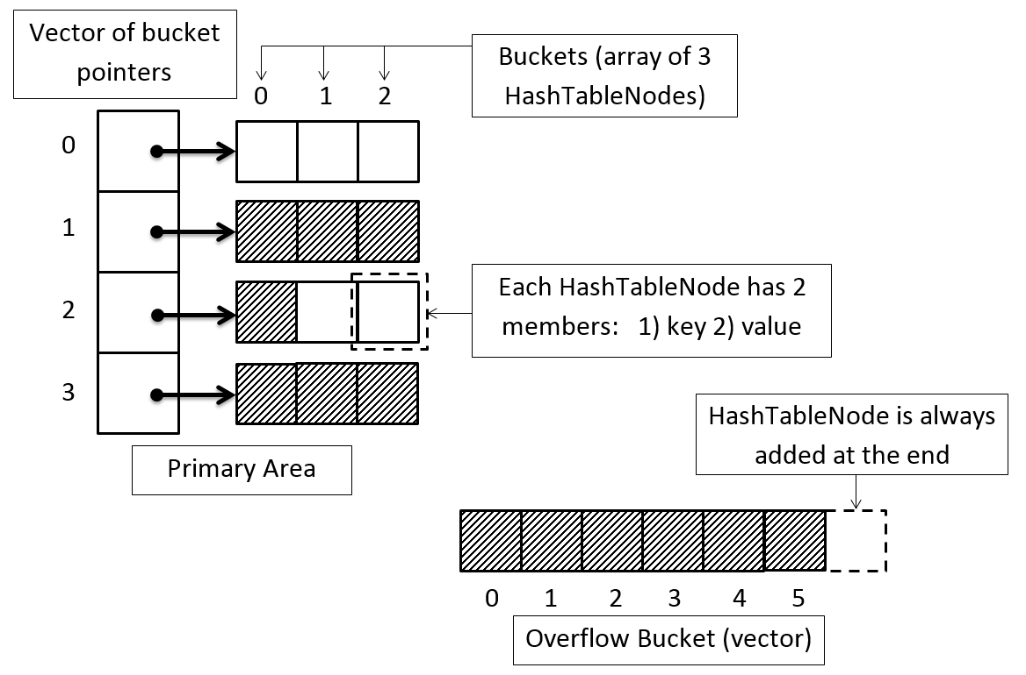
HASH TABLE DIAGRAM
Notes:
This is the structure diagram of the hash table.
For primary area, we use a vector to store pointers to buckets. Each bucket is a dynamically allocated array of 3 HashTableNodes.
In this figure, bucket#1 and 3 are empty, bucket#2 is full and bucket#4 has one entry in it.
For overflow area, we use a vector of HashTableNodes. New elements are added to this vector whenever primary area does not have space for the new entry being added.

Slide 8
HASH FUNCTION
Hash Function maps a string key to a bucket in the primary area.
template <class T> int HashTable<T>::Hash(string key) {
int sum = 0;
for (unsigned int i = 0; i < key.size(); ++i) {
sum += key.at(i);
}
return sum % num_buckets;
}
Notes:
Lets look at the hash function we used in our HashTable.
So, hash function is a function that maps a string key to a bucket in the primary area.
In our hash function, we sum the ascii values of all the characters in the key. Then we take mod of this sum with the number of buckets in the hash table.
The hash function gets used in almost all HashTable methods.

Slide 9
HASH TABLE CODE
template <class T> void HashTable<T>::Insert(string key, T* insert_valuePtr) {
++current_size;
int bucket_no = Hash(key); // Hash the key.
// Insert in primary bucket at 'bucket_no' index.
for (int j = 0; j < BUCKET_SIZE; ++j) {
if (buckets[bucket_no][j].value != NULL) {
buckets[bucket_no][j].key = key;
buckets[bucket_no][j].value = insert_valuePtr;
return;
}
}
// Insert in overflow bucket.
HashTableNode hashTableNode(key, insert_valuePtr);
overflow_bucket.push_back(hashTableNode);
}
Notes:
To give you some idea on what the implementation of our hash table looks like, I’ll walk you through the implementation of Insert function of the hash table.
The Insert function takes 2 parameters. A string key and an object pointer to store corresponding to the key.
In this function, we first increment the current_size variable that stores the number of entries in the hash table.
Then, we compute the hash of the key to find the bucket in which the object pointer should be stored.
We then iterate over the bucket, which is of size 3, to find an empty slot in it. If we find an empty slot in the bucket, we insert the object pointer in that slot and return from the method.
If no empty slot exists in the bucket, we insert the object pointer in the overflow area. Note that the object pointer and the key are stored together as HashTableNode in the hash table.

Slide 10
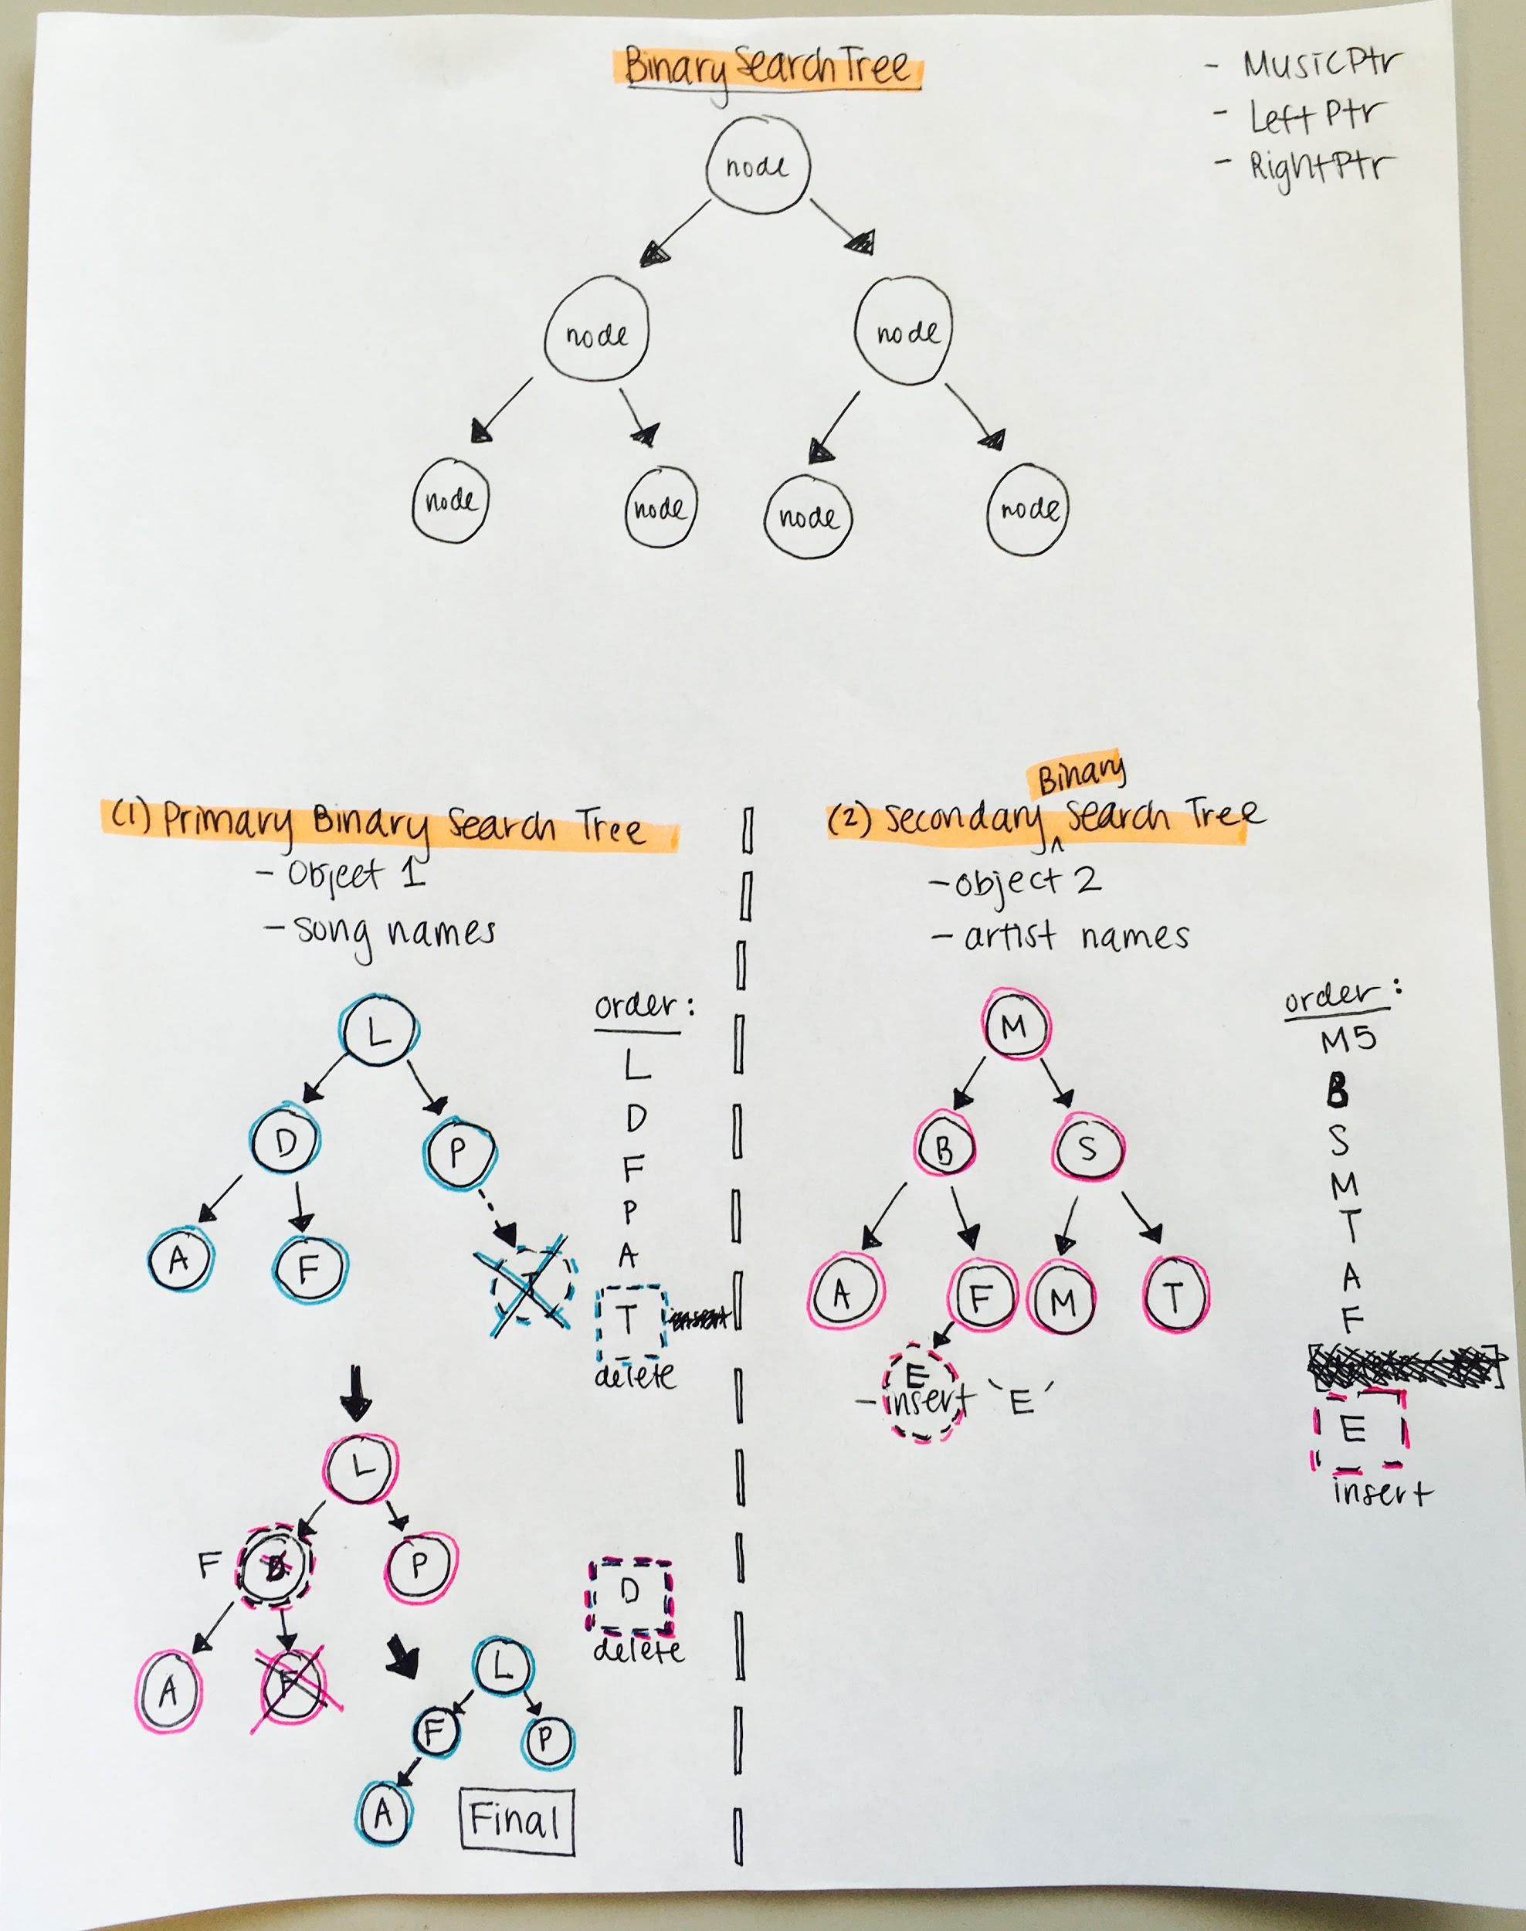
BINARY SEARCH TREE

Slide 11
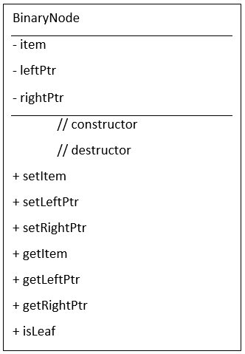
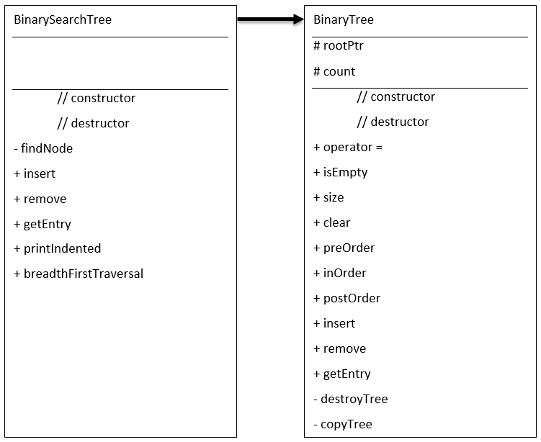
BINARY SEARCH TREE UML DIAGRAMS

Slide 12
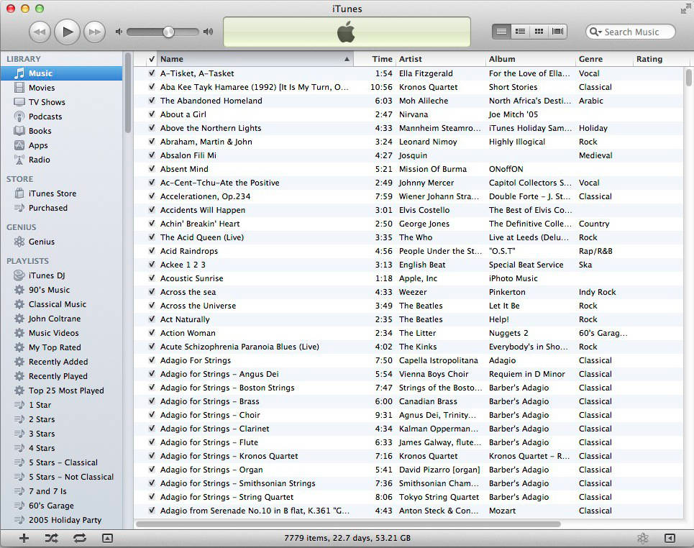
FUTURE IMPLEMENTATION
Things we could add in the future to this music database:
Playlists
Top 25 songs most viewed (as in Itunes)
Recently Added Songs
Recently Deleted Songs

Slide 13
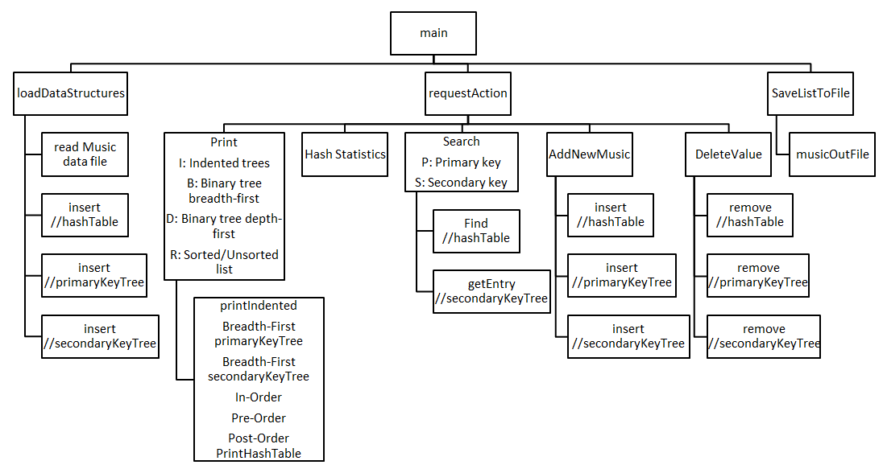
STRUCTURE CHART

Slide 14
MENU
************* MUSIC DATABASE MENU *************
I : Print Indented Trees
B : Print binary tree Breadth-First Traversals
D : Print binary tree Depth-First Traversals
R : Print Sorted/Unsorted list
T : Print Hash Table Statistics
P : Search by primary key (Song Name)
S : Search by secondary key (Artist Name)
A : Add new song to the file
E : Erase/Delete a song from the file
V : Save Music to the file
H : Help - to show the menu
Q : Quit
************************************************
Please enter a letter to perform one of the Menu operations:

Slide 15

THANK YOU
Questions?

